Slide 1
The Simulation Hypothesis & Social Knowledge
Grace Helton
Princeton University

Slide 2
Plan for the Talk
Explain some of the intellectual background of Chalmers’ book.
Discuss some of Chalmers’ claims about knowledge in the simulation hypothesis, especially as they relate to knowledge of other minds.
Introduce my claim that the value of social knowledge for a meaningful life dramatically swamps the value of non-social knowledge.

Slide 3
Some Background to Chalmers’ book..
Knowledge, skepticism, and the simulation hypothesis

Slide 4
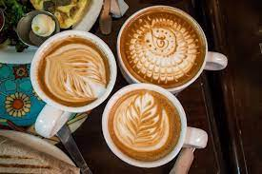
Suppose..
You are drinking coffee in a café, chatting with a friend about your lives…

Slide 5
You think, you believe, “I am drinking coffee with my friend, and we’re both happy and relaxed.”

Slide 6
But, could it turn out that this isn’t true? Or that if this is true, you don’t know this?

Slide 7
Merely True Belief vs Knowledge
If I believe that it’s Thursday, but only because I’m looking at an outdated calendar, I don’t know it’s Thursday, even if it happens to be true.
My belief is too accidental or lucky.

Slide 8
Historically…
Philosophers have worried that if we don’t know we’re not dreaming (or a dreaming butterfly) or deceived by an evil demon, we don’t really have knowledge of things like …
I’m drinking coffee in a café.

Slide 9
But maybe these possibilities are too silly to worry about
Why think I’m dreaming if I seem awake enough? Why think an evil demon is deceiving me if I don’t think demons exist, etc.

Slide 10
In contrast to these scenarios…
…There is some reason (some) to take the simulation hypothesis seriously, or at least, more seriously than the possibility that I might be deceived by a demon, where I have no reason to think this.

Slide 11
The Simulation Hypothesis
This is the claim that we, our environment, and everything in it is a wide-scale computer simulation, one rendered (perhaps) by superintelligent AI.

Slide 12
Should We Take the Hypothesis At All Seriously?
Maybe, maybe not.
But, Bostrom (2003) develops some reason (again, just some) to think it’s true.

Slide 13
Should We Take the Hypothesis At All Seriously?
Roughly, Bostrom argues that:
If superintelligent AI which develop…

Slide 14
Should We Take the Hypothesis At All Seriously?
And..
If these superintelligent AI are so powerful to create a huge number full-scale simuations of civilzations, complete with billions of conscious beings…

Slide 15
Should We Take the Hypothesis At All Seriously?
And..
If these AI would have an interest in creating such scenarios, such as for entertainment or research…

Slide 16
Should We Take the Hypothesis At All Seriously?
Then chances are, we are in such a scenario.

Slide 17
Should We Take the Hypothesis At All Seriously?
For, if there are millions or billions of full-scale civilizations much like ours, the chances that ours is not simulated are low.

Slide 18
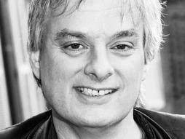
David Chalmers…
…does not endorse the simulation hypothesis, but he thinks it probable enough to contemplate what it would matter if we were living in a simulation.

Slide 19
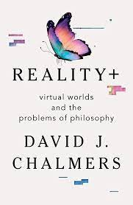
In Reality+…
Chalmers also considers a number of questions about, e.g, the reality and value of more local virtual reality more generally.

Slide 20
Plan for the Talk
Explain some of the intellectual background of Chalmers’ book.
Discuss some of Chalmers’ claims about knowledge in the simulation hypothesis, especially as they relate to knowledge of other minds.
Introduce my claim that the value of social knowledge for a meaningful life dramatically swamps the value of non-social knowledge.

Slide 21
About the simulation hypothesis…
…Chalmers claims:
We’d know a lot of things in it.
Many things would be real.
We could (at least in principle) have meaningful lives in the simulation.

Slide 22
Think about the café…
If you are in the simulation..
Chalmers claims your coffee is still real, as are your cups.
You can know this and,
If your friend is also real, as she might be, this experience could be a genuine, one that is potentially part of a meaningful life.

Slide 23
Suppose that God made everything from ‘bits,’ digital information
Call this the ‘its-from-bits’ hypothesis.

Slide 24
The “Its from Bits” Hypothesis
“The it-from-bit creation hypothesis is not a hypothesis in which nothing is real. It’s not a hypothesis in which there are no tables and chairs; it’s a hypothesis in which tables and chairs are made of bits” (Chalmers, ch. 9)

Slide 25
Chalmers says that in the simulation
These things would still be real.
It’s just that they’d be made up of something surprising, digital information.

Slide 26
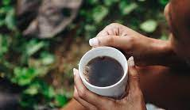
Why does Chalmers think the coffee mug is real?
Roughly, what it is to be a coffee cup is to
To tend to do certain things, like
Being usable for drinking,
Being able to hold liquid,
Having a certain rigidity, etc.

Slide 27
But wait, what about the mug’s solidity, or ceramic materials?
Surely, if we are living in a simulation, the mug isn’t solid or isn’t (really) made out of ceramic materials!

Slide 28
Chalmers denies this…
Being solid is also reducible to a kind of tendency to do certain things, for instance, to remain intact despite pressure.

Slide 29
On the most radical version of this view…
External, ‘worldly’ entities, such as solid things, coffee mugs, and molecules just are as they do.
They are a set of observable dispositions to plays certain causal roles.

Slide 30
But can we know about these things in the simulation?
Recall that if you know that (say) you are drinking coffee, this is more than just believing it and it’s being true.
It’s that you access it on the basis of good evidence, such as reliable evidence.
Chalmers argues (later in the book) that you can know that there is a mug just by knowing its observable roles because that’s all the mug is.

Slide 31
Structuralism and Other Minds
Let’s suppose structuralism is true of things like coffee cups, molecules, and solid things.
Is it true of everything in the world?
Chalmers thinks, no. For one thing, it’s not true of the mental states of others.

Slide 32
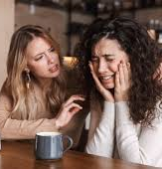
Structuralism and Other Minds
Consider your friend in the café, suppose she seems sad for a moment,
Being sad is not the same as any causal tendency you might observe.

Slide 33
Sadness is an Inner State..
It has certain characteristic manifestations:
Facial expressions
Postures
Crying,
etc.

Slide 34
Elsewhere, I’ve argued…
Structuralism doesn’t vindicate knowledge of others’ mental states, even if we accept a kind of physicalism or non-reductive functionalism about the mind…

Slide 35
Elsewhere, I’ve argued…
This means structuralism fails to vindicate surprisingly vast swathes of our knowledge across domains (Helton, forthcoming).

Slide 36
This claim is not in conflict with Chalmers’ own ambitions for structuralism.
His aim is to vindicate physical, non-mental forms of worldly knowledge,
Such as knowledge about atoms, shrubs, etc.

Slide 37
At the same time, Chalmers briefly suggests that…
The fact that in the simulation, we would know much about our world helps forestall the concern that in the simulations our lives would lack meaning (314).

Slide 38
Plan for the Talk
Explain some of the intellectual background of Chalmers’ book.
Discuss some of Chalmers’ claims about knowledge in the simulation hypothesis, especially as they relate to knowledge of other minds.
Introduce my claim that the value of social knowledge for a meaningful life dramatically swamps the value of non-social knowledge.

Slide 39
Here, I want to suggest that if we don’t know about other minds….
For many of us, this threatens the meaningfulness of our lives, much more so than if we (merely) don’t know about things like atoms and shrubs.

Slide 40
This is the social swamping thesis:
For at least many of us, the value of social knowledge (knowledge of other minds) dramatically swamps the value of non-social knowledge (e.g., knowledge of atoms and shrubs) for the value of our lives.

Slide 41
A Hybrid View of Life’s Meaningfulness
I’m assuming a kind of hybrid view, on which a meaningful life is both a matter of one’s own preferences and a matter of objective goods.

Slide 42
I will explore a stronger & weaker version of the thesis..
….I think both are attractive and at least one is true!

Slide 43
Social Swamping View (Strong Version)
There are at least some meaningful lives, meaningful partly in virtue of their socially rich aspects, which are such that lacking knowledge about non-social reality detracts not at all from the meaningfulness of those lives.

Slide 44
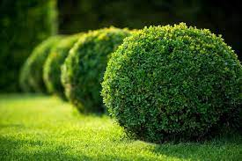
The Strong View Seems Initially Implausible Because…
Consider someone whose life is thoroughly meaningless- she is thwarted in her aims, lacks relationships, etc., but she does know something about the non-social parts of reality.

Slide 45
The Strong View Seems Initially Implausible Because…
Intuitively, this person’s life is at least a little bit meaningful in virtue of her knowledge of the non-social realm.

Slide 46
I Think This Intuition is Correct…
…But it doesn’t conflict with the strong view I just described.

Slide 47
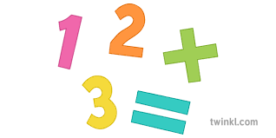
Any Sense of Conflict Comes from An Additive Model of Life’s Meaningfulness…
…on which a life’s total meaningfulness is a matter of ‘adding up’ valuable things, each of whose value is determined independently of what else is in a life.

Slide 48
If Life’s Meaningfulness Is Additive, then…
It can’t BOTH be true that some people’s otherwise rich lives aren’t degraded at all by the fact that they lack non-social knowledge.
And.. That someone whose life is elsewise meaningless gains meaning form non-social knowledge.

Slide 49
I think the Additive Model is False…
I propose instead a non-additive model, on which the effect some potential source of value has on a life’s meaningfulness ….
Depends on what is already in that life.

Slide 50
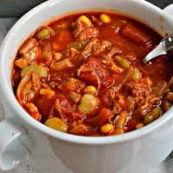
Life’s Meaningfulness is A Bit Like a Stew…
A little salt might dramatically change the flavor of plain water
but might not change at all the flavor of a rich and well-flavored stew, depending on its existing flavor profile.

Slide 51
The Strong Social Swamping View:
There are at least some meaningful lives, meaningful partly in virtue of their socially rich aspects, which are such that lacking knowledge about non-social reality detracts not at all from the meaningfulness of those lives.

Slide 52
But Is There Anything In Favor of the Strong Social Swamping View?
Consider Alya.
Alya has safety, shelter, food, and other basic necessities, but also music, art, love, and community. Her work is valuable and rewarding; her relationships are not without challenges, but they are intimate and reciprocated…

Slide 53
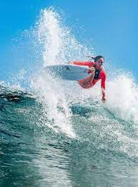
Maybe Alya…
... is madly in love with someone she just met; maybe she enjoys the companionship of several decades-old, platonic relationships. Maybe she engages in the rituals of an ancient religion; maybe she follows no religion and surfs a lot.

Slide 54
Alya’s Is Intuitively Meaningful Even If…
… she somehow lacks non-social knowledge, e.g., knowledge about shrubs and atoms, either because she is somehow in an environment where these things don’t exist or because her route of access them is systematically epistemically flawed.

Slide 55
Arguably, it would be disrespectful..
Both to Alya’s preferences and to the objective sources of value in Alya’s life to maintain that the meaningfulness of her life is degraded because she doesn’t know about things like shrubs and aotms.

Slide 56
On this view…
A meaningful life can be anchored by deeply valuable things which prevent its from being axiologically unmoored by things like lacking non-social knowledge.

Slide 57
Let’s Turn to Social Swamping Thesis (Weak):
There are at least some very meaningful lives, meaningful partly in virtue of their socially rich aspects, which are such that lacking knowledge about non-social reality scarcely detracts from the meaningfulness of those lives.

Slide 58
Suppose God tells you none of your beliefs about atoms or shrubs amount to knowledge…
….Either because there aren’t things like atoms or shrubs or because your way of forming these beliefs is based on bad evidence.

Slide 59
Certainly you’d be shocked….
…but after that wore off, you’d probably also be deeply curious or even delighted, since this would introduce an element of mystery into the every day.

Slide 60
By comparison…
Suppose God told you that none of your beliefs about others’ mental states amount to knowledge…

Slide 61
Either because….
They are mere automata without minds or because your beliefs are based on bad evidence..

Slide 62
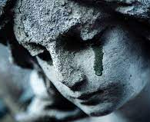
Presumably your emotional response would be..
One of grief and horror

Slide 63
Let’s Turn to Social Swamping Thesis (Weak):
There are at least some very meaningful lives, meaningful partly in virtue of their socially rich aspects, which are such that lacking knowledge about non-social reality scarcely detracts from the meaningfulness of those lives.

Slide 64
SO, the fact that structuralism…
….doesn’t vindicate knowledge of other minds should tell us that we need some other route to knowing about minds in the simulation hypothesis,
Otherwise, the hypothesis is deeply horrifying.

Slide 65
Conclusion…
If our lives are to be valuable in the simulation, we need structuralism + [some other epistemological solution] OR some broader epistemological theory which could vindicate both non-social and social knowledge simultaneously.

Slide 66
Other Routes to Knowledge of Other Minds??
Inference to the best explanation
This is complicated by the simulation – what are the intentions, are they aware of ethical problems with simulating people, etc.
A new problem of evil – if our creators are all-knowing and omniscient, etc, why did they do this?

